Slide 1
SQL Server Clustering 101
Denny Cherry
mrdenny@mrdenny.com
twitter.com/mrdenny

Slide 2
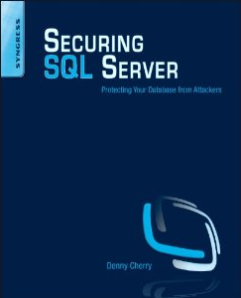
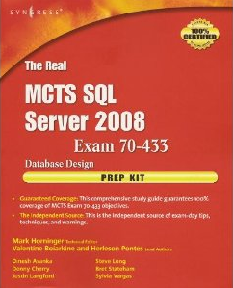



About Me
Author or Coauthor of 4 books
6+ SQL Mag articles
Dozens of other articles
Microsoft MVP since Oct 2008
Microsoft Certified Master
Sr. DBA for Phreesia

Slide 3
Microsoft Cluster Service
What it does do
What it doesn’t do
Provides redundant hardware
Allows for 99.999% service uptime
Provides Geographical Redundancy
Allows for system maintenance without taking down application
Provide CPU scale out functionality
Provide redundant storage
Load balance between nodes

Slide 4
Cluster Terminology
Node = Server
Virtual World = Independent Hostname and IP Address
Cluster Root = Initial Virtual World
Resource = General name for clustered objects (hard drive, IP Address, hostname, service, etc)
Resource Group = Logical Group of several Resources
Active Node = Node which runs the service(s) in question
Passive Node = Node which is not running the service(s) in question

Slide 5
Hardware Requirements
2 Servers with 2 NICs each (1 NIC is required, 2 is recommended)
One IP Subnet for each NIC
Shared storage accessible by all nodes in the cluster
  SCSI storage supports 2 nodes
  Fibre Channel is required for over 2 nodes
    Windows 2000 up to 4 nodes
    Windows 2003 up to 8 nodes
    Windows 2008 up to 16 nodes

Slide 6
Software Requirements
Any Server Operating System Enterprise or Datacenter Edition
  Windows 2003
    Enterprise Edition – 4 Nodes
    Datacenter Edition – 8 nodes
  Windows 2008
    Itanium – 8 Nodes
    x86 / x64 – 16 Nodes
SQL 2000 requires Enterprise Edition
SQL 2005/2008
  Standard Edition – 2 Nodes
  Enterprise Edition – OS Maximum
6 IP Addresses

Slide 7
Typical Hostname / IP Address Config
SQL01A – 10.0.0.5 / 192.168.0.1 – Node 1
SQL01B – 10.0.0.6 / 192.168.0.2 – Node 1
SQL01 – 10.0.0.7 – Cluster Root
SQL01V01 – 10.0.0.8 – SQL Server Instance

Slide 8
SQL Instance Requirements
Each instance requires it’s own virtual world
Each instance requires it’s own hard drive

Slide 9
Configuration Process
Configure NICs
Assign and Format Shared Storage
Configure Windows Cluster and setup Cluster Root
Create Resource Group for SQL Server
Move SQL Server hard drives to new Resource Group
Install SQL Server from the active node for the resource group
Patch as needed

Slide 10
Special Notes
Only SQL Server and Analysis Services are cluster aware
  To cluster Integration Services install manually on the second node and patch separately
  Integration Services can be clustered by manually making the SSIS Service a cluster resource
  Reporting Services should be load balanced not clustered
  Static IPs are required for Windows 2003 and below, and recommended for Windows 2008

Slide 11
Denny Cherry
mrdenny@mrdenny.com
http://itke.techtarget.com/sql-server
Please fill out the session survey at http://speakerrate.com/mrdenny

